Slide 1
Pictures to accompany the Bible Stories
used in the Kindergarten Curriculum
God is Provider

Slide 2
Provider Week 1

Slide 3
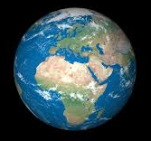
Provider Week 1

Slide 4
Provider
Week 2

Slide 5
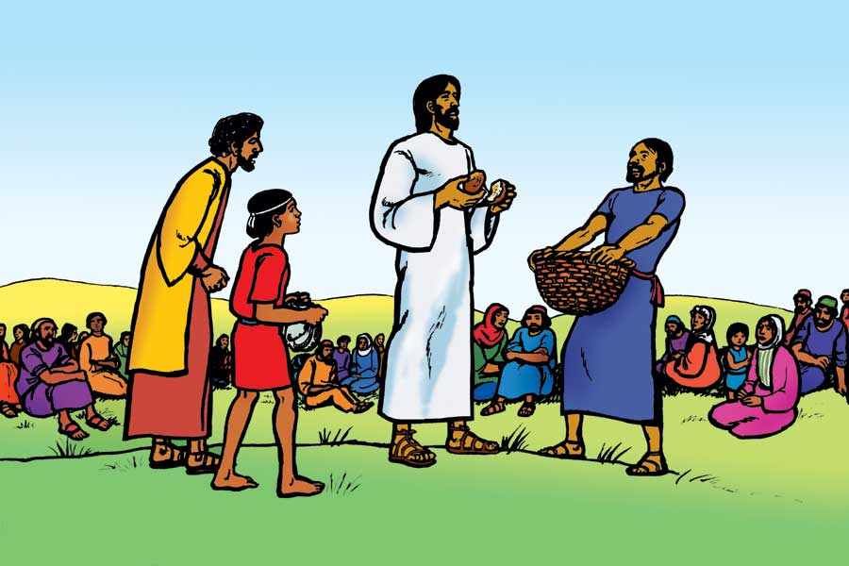
Provider
Week 3

Slide 6
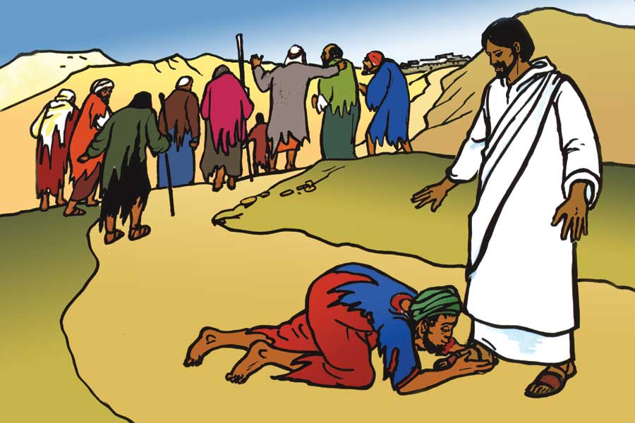
Provider
Week 3

Slide 7
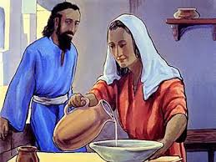
Provider Week 4

Slide 8
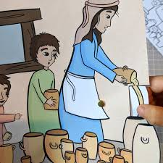
Provider Week 5

