Slide 1
Pictures to accompany the Bible Stories
used in the Kindergarten Curriculum
God is our Saviour

Slide 2
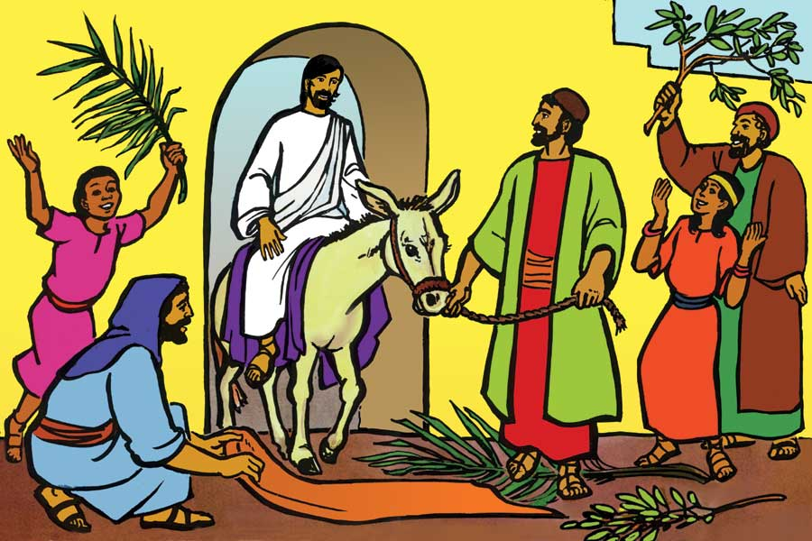
Saviour Week 1

Slide 3
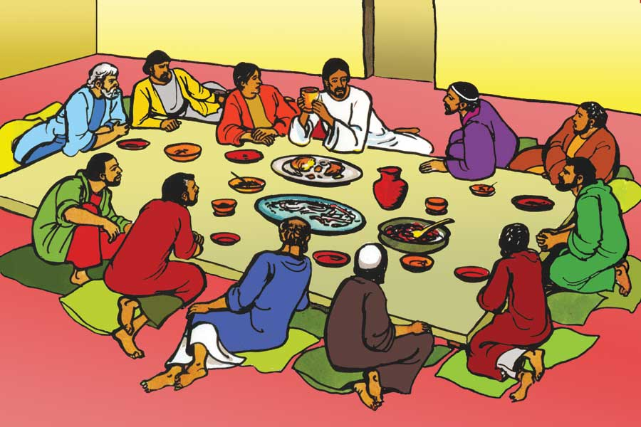
Saviour Week 1

Slide 4
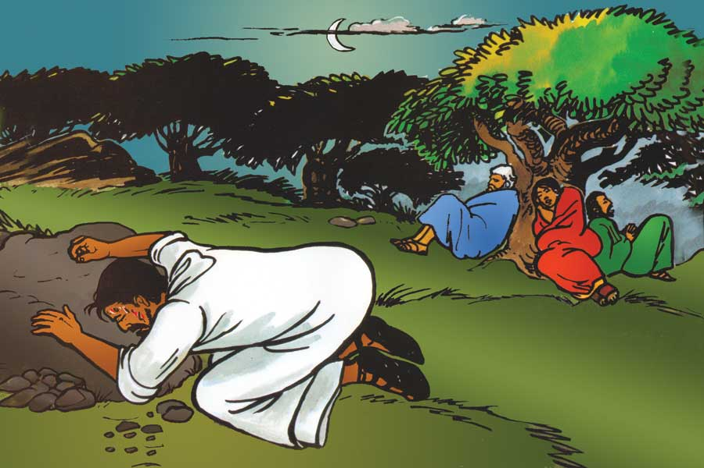
Saviour Week 1

Slide 5
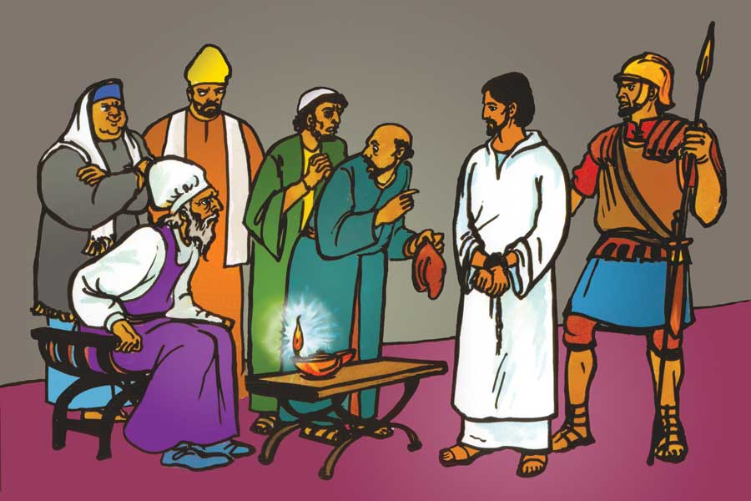
Saviour Week 2

Slide 6
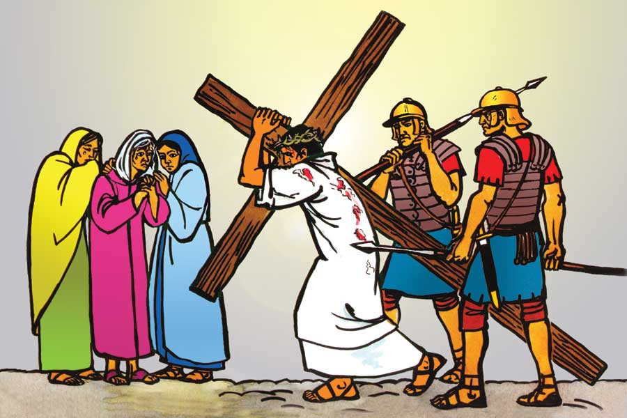
Saviour Week 2

Slide 7
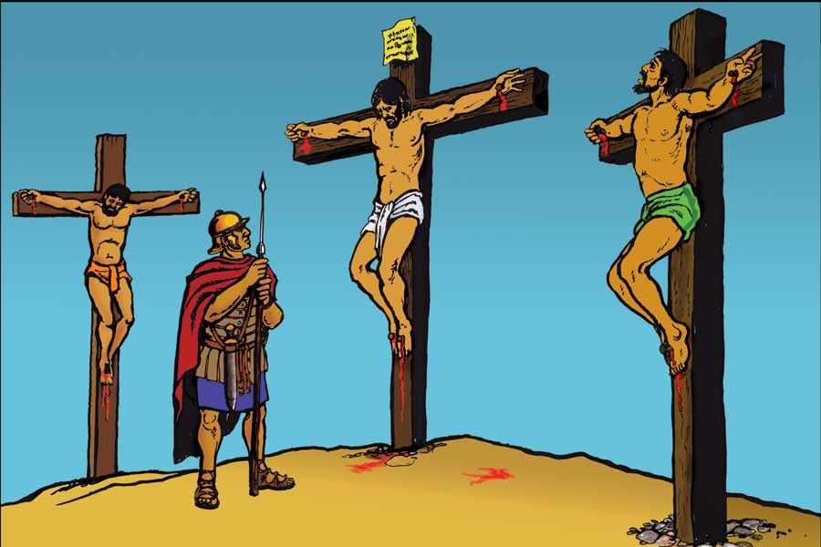
Saviour Week 2

Slide 8
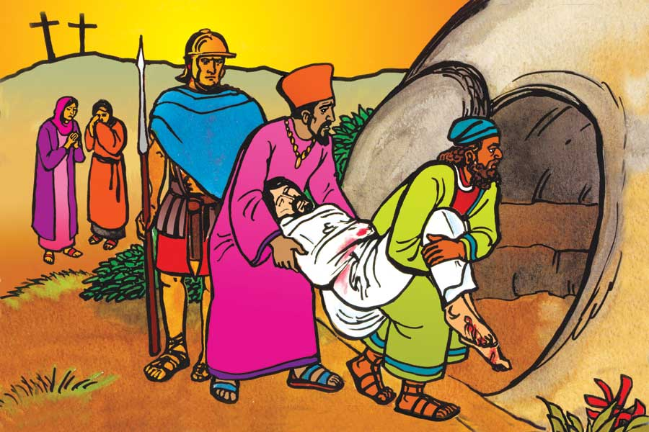
Saviour Week 2

Slide 9
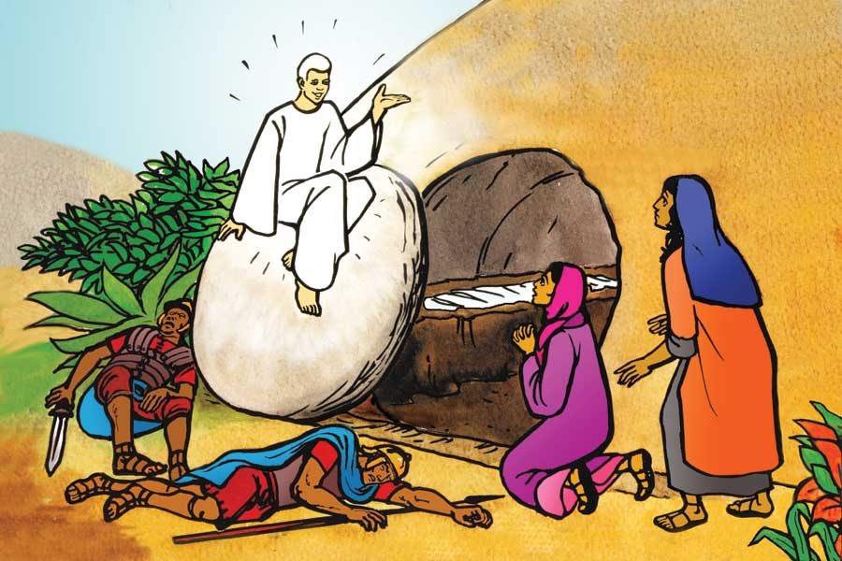
Saviour Week 2

Slide 10
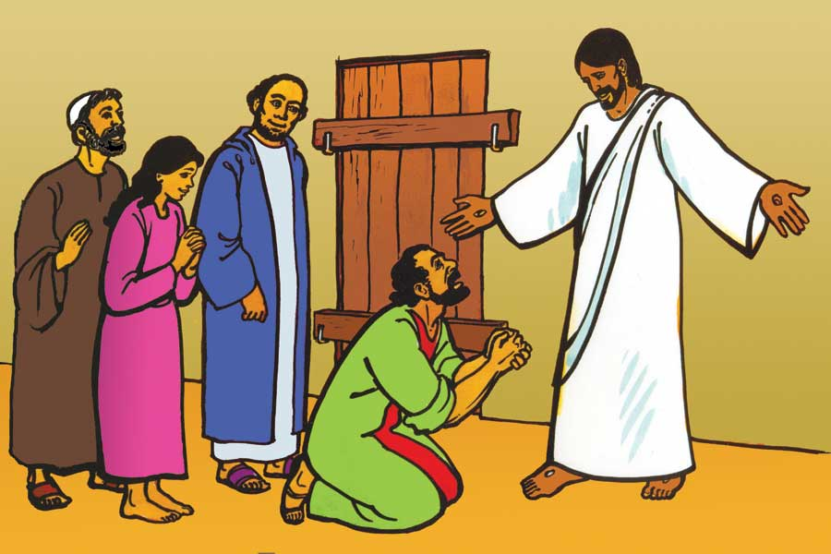
Saviour Week 2

Slide 11
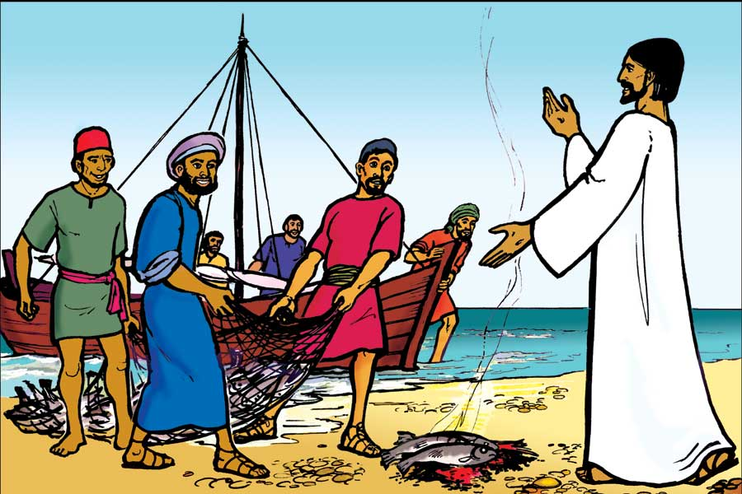
Saviour Week 2

Slide 12
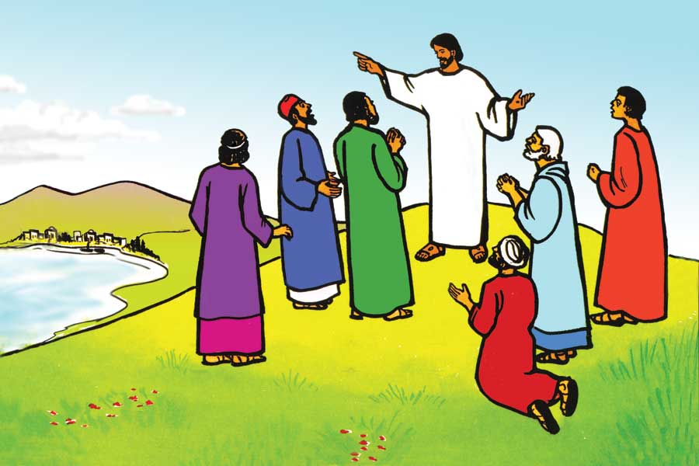
Saviour Week 3

Slide 13
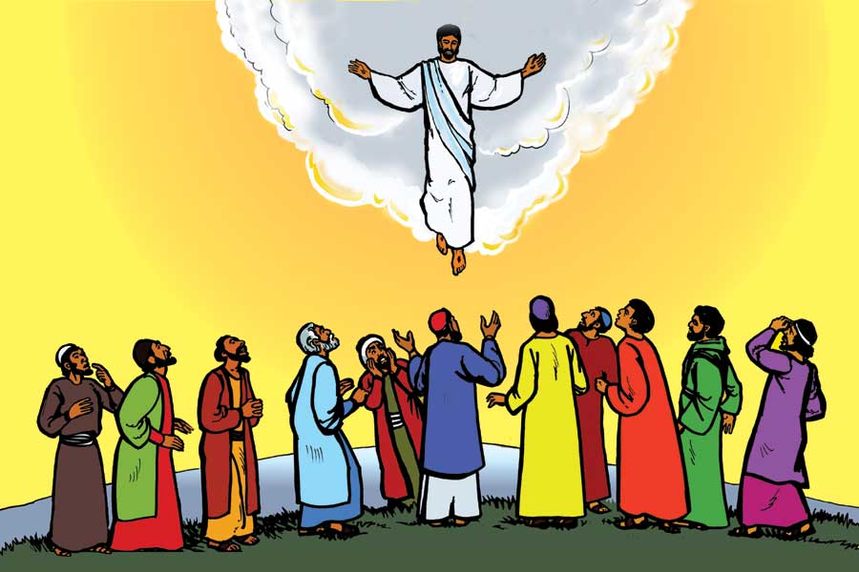
Saviour Week 3

