Slide 1
Pictures to accompany the Bible Stories
used in the Kindergarten Curriculum
God is Wise

Slide 2
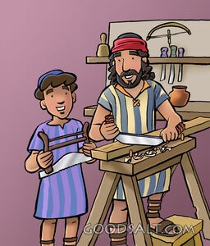
Wise Week 1

Slide 3
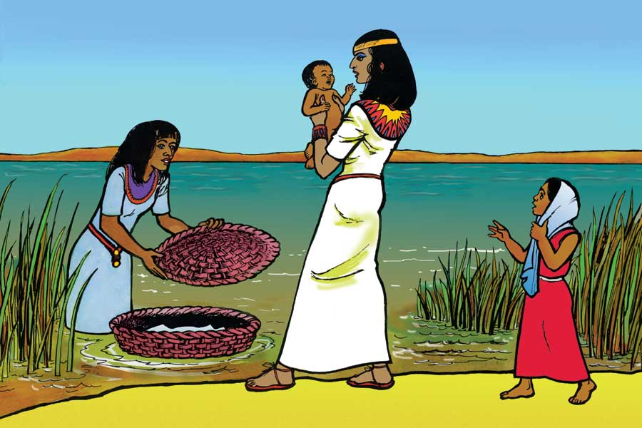
Wise Week 2

Slide 4
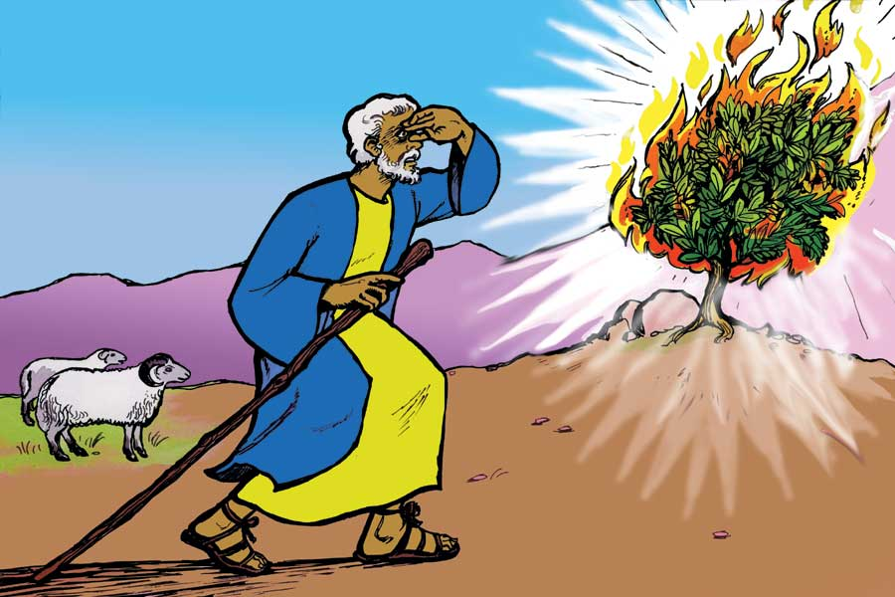
Wise Week 2

Slide 5
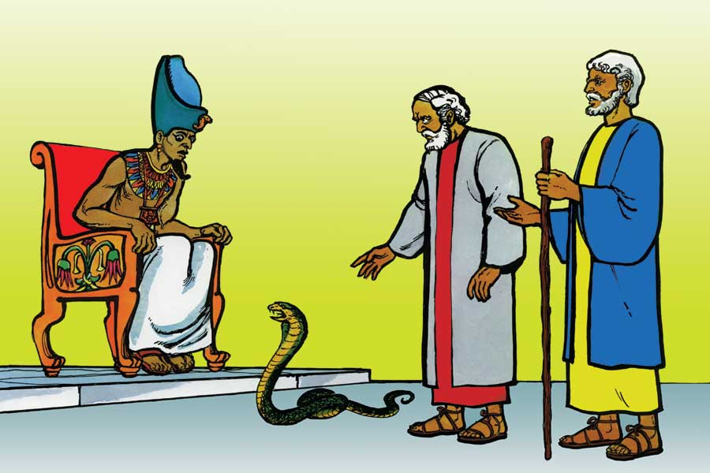
Wise Week 2

Slide 6
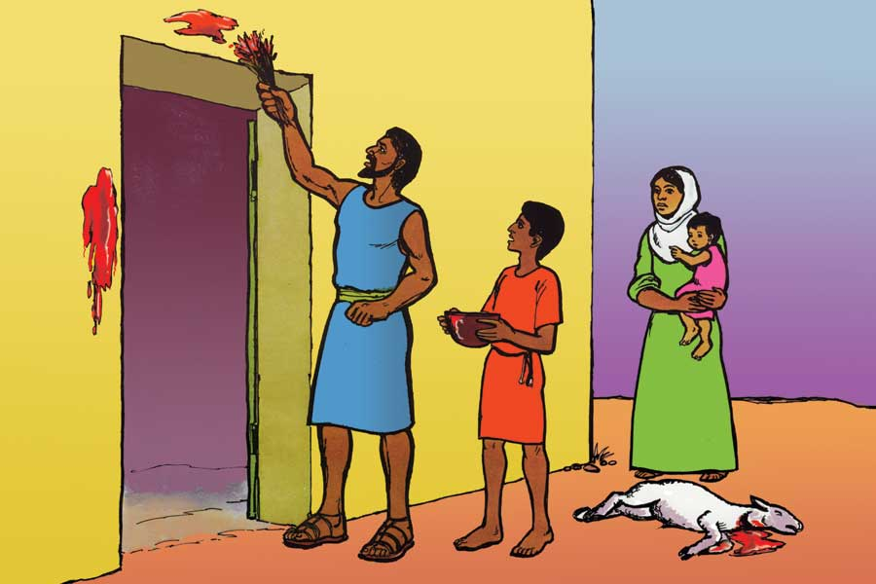
Wise Week 2

Slide 7
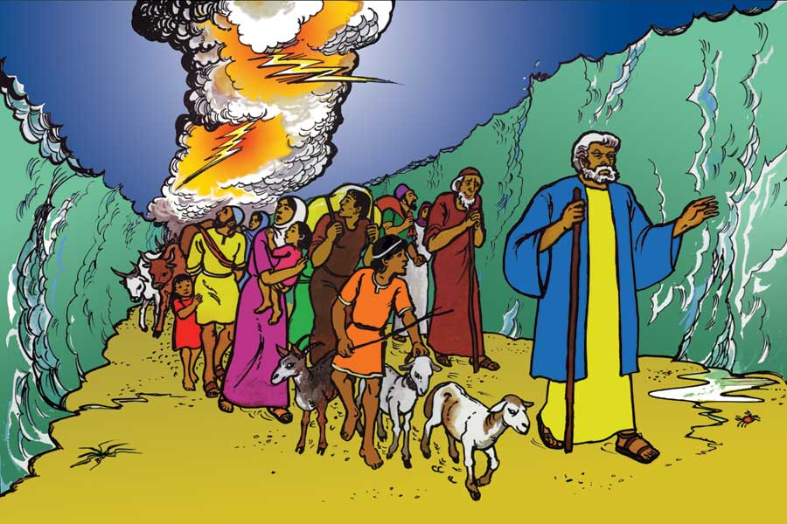
Wise Week 2

Slide 8
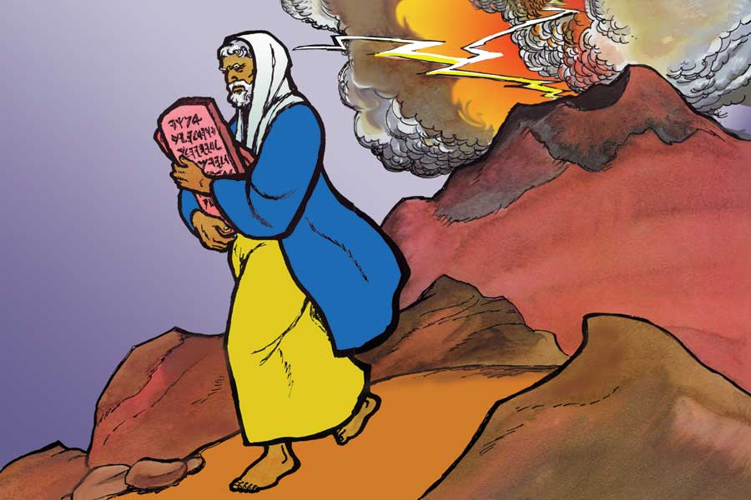
Wise Week 2

Slide 9
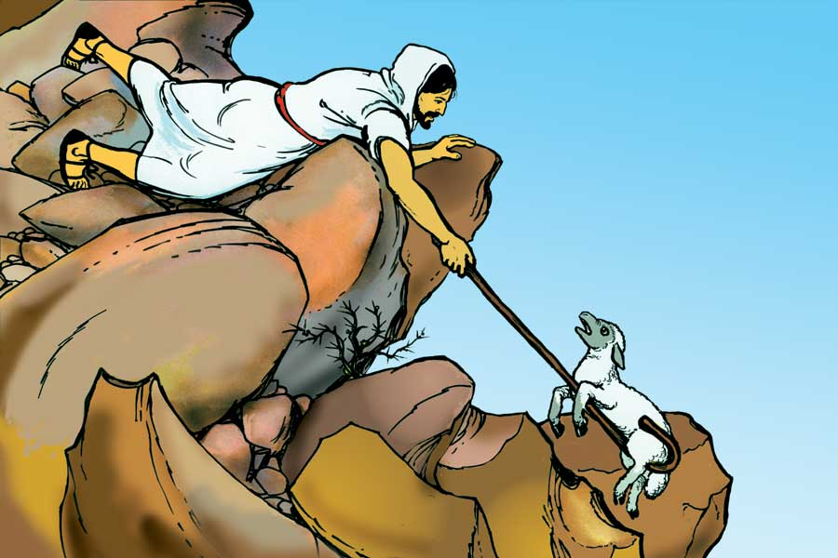
Wise Week 3

Slide 10
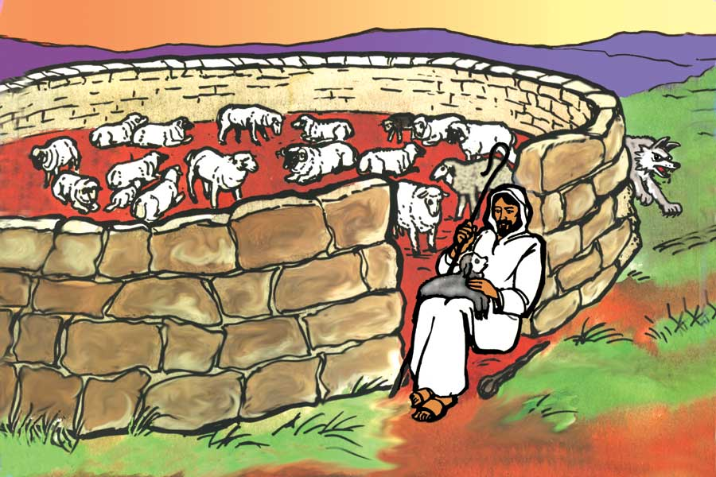
Wise Week 3

Slide 11
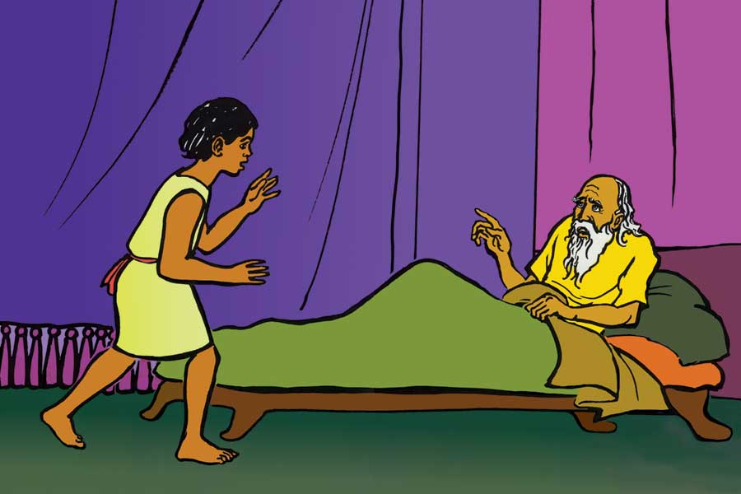
Wise Week 4
Samuel

Slide 12
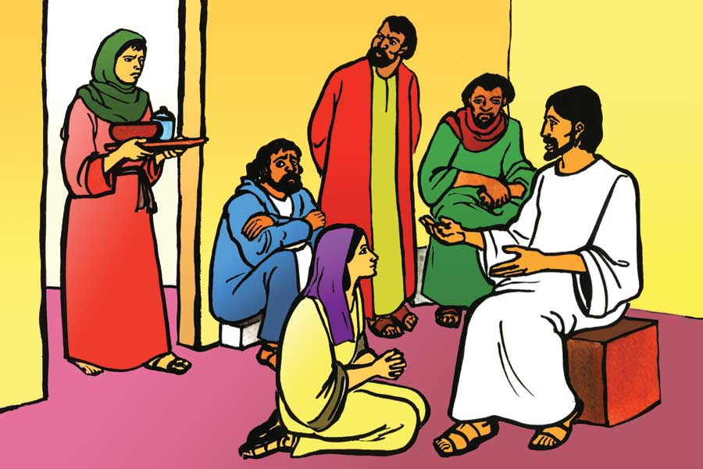
Wise Week 4

