Slide 1
Pictures to accompany the Bible Stories
used in the Kindergarten Curriculum
God is Truth

Slide 2
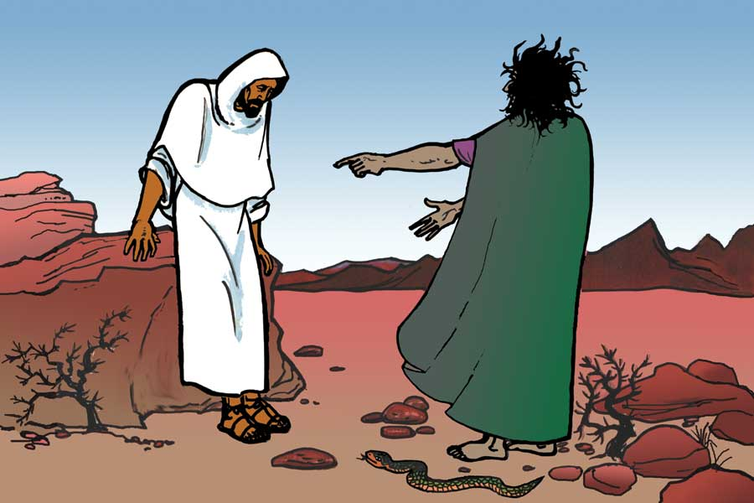
Truth Week 1

Slide 3
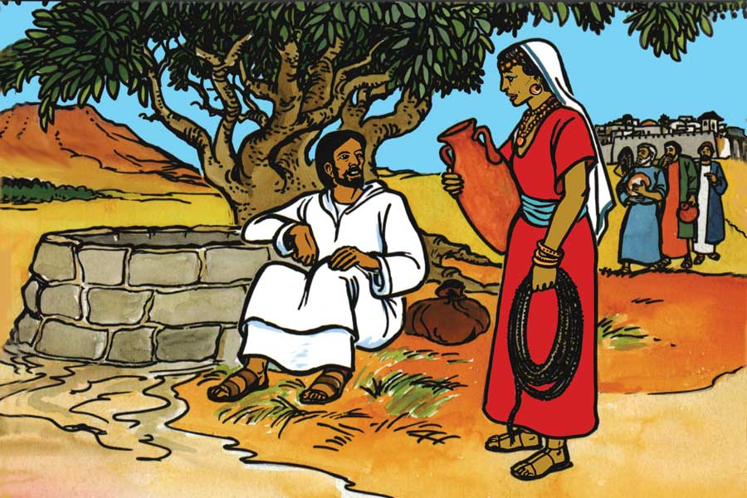
Truth
Week 2

Slide 4
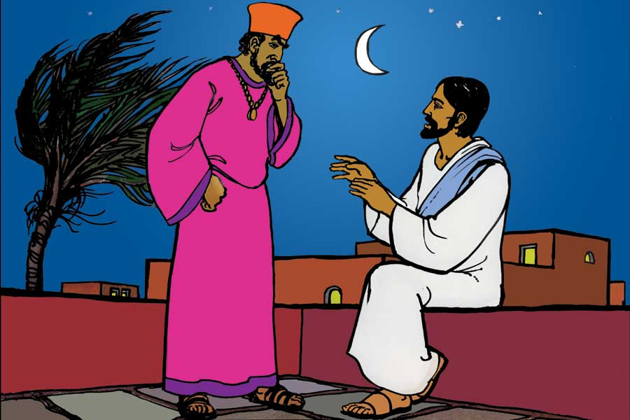
Truth
Week 3

Slide 5
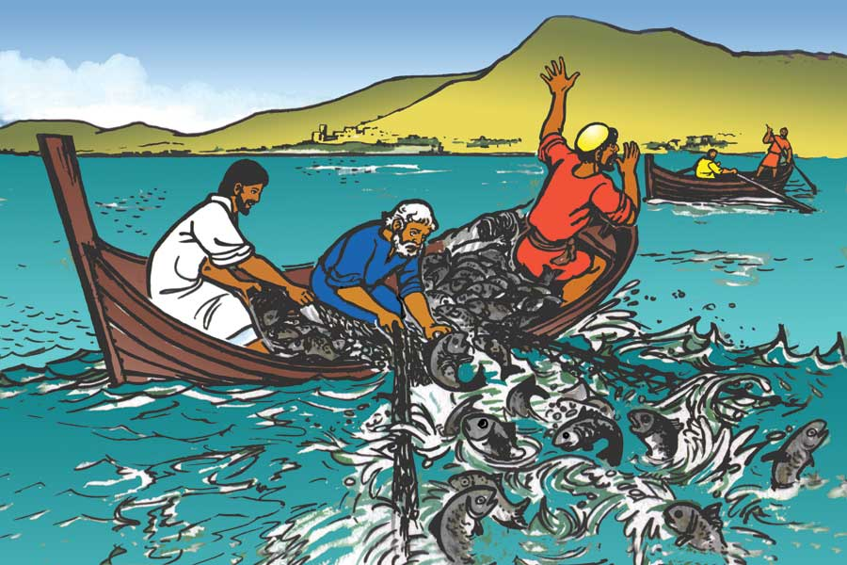
Truth
Week 3

