Slide 1
Pictures to accompany the Bible Stories
used in the Kindergarten Curriculum
God is Love

Slide 2
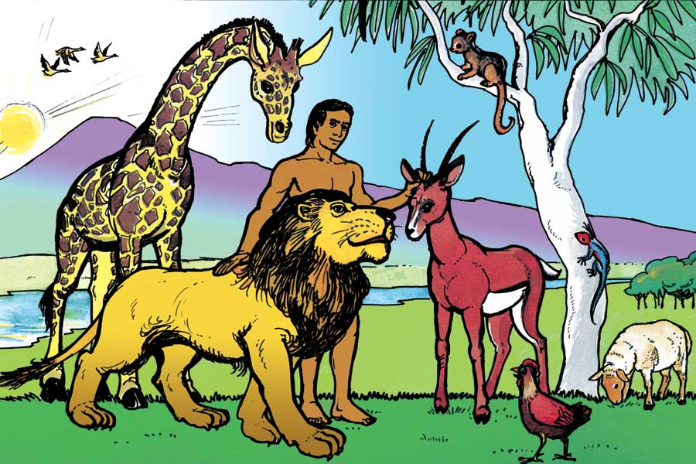
Love Week 1

Slide 3
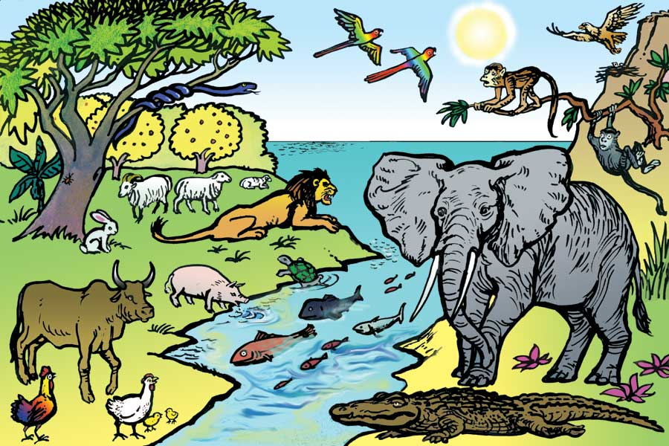
Love Week 1

Slide 4
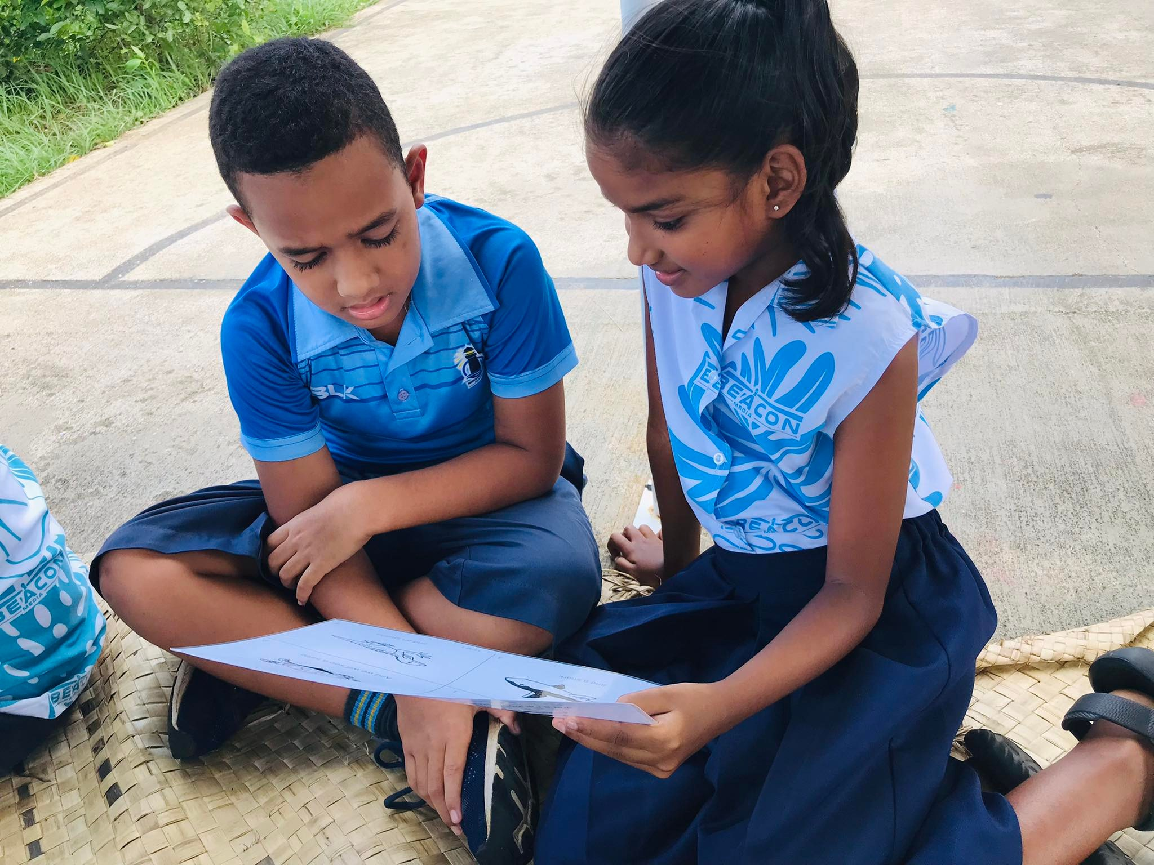
Love Week 2

Slide 5
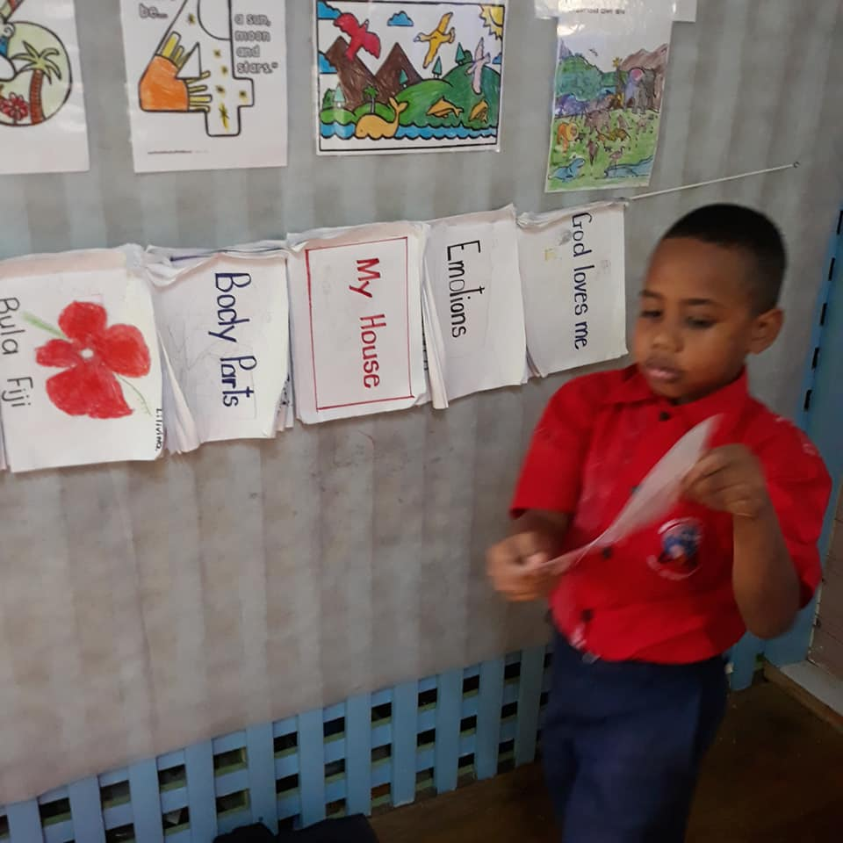
Love Week 3

Slide 6
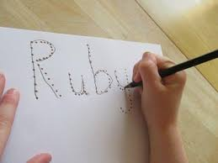
Love Week 4
God knows my name

Slide 7
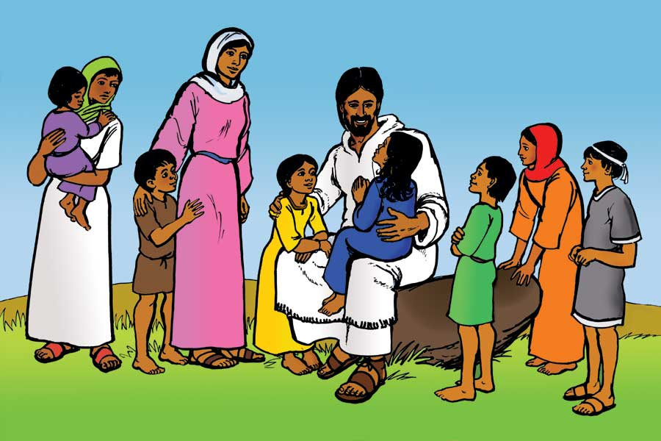
Love Week 5

