Slide 1
PUPPETRY

Slide 2
PUPPETRY AS A CREATIVE ARTFORM
Students enjoy puppetry because they are able to use their creative talents. Students can:
Make their own puppet.
Write or record their own scripts.
Manipulate puppets with a little training.
Entertain and inform.

Slide 3
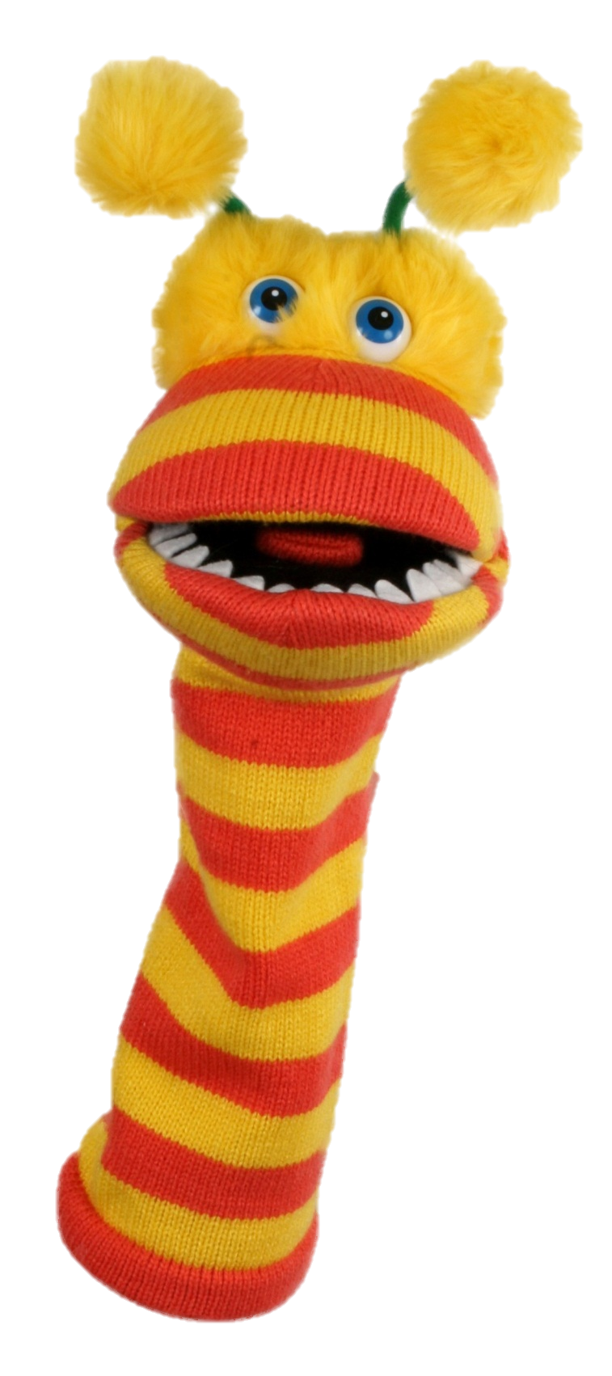
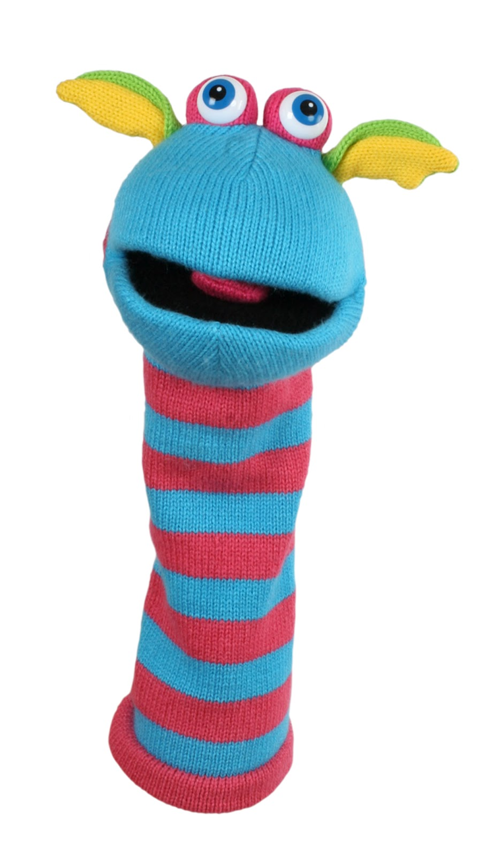

Slide 4
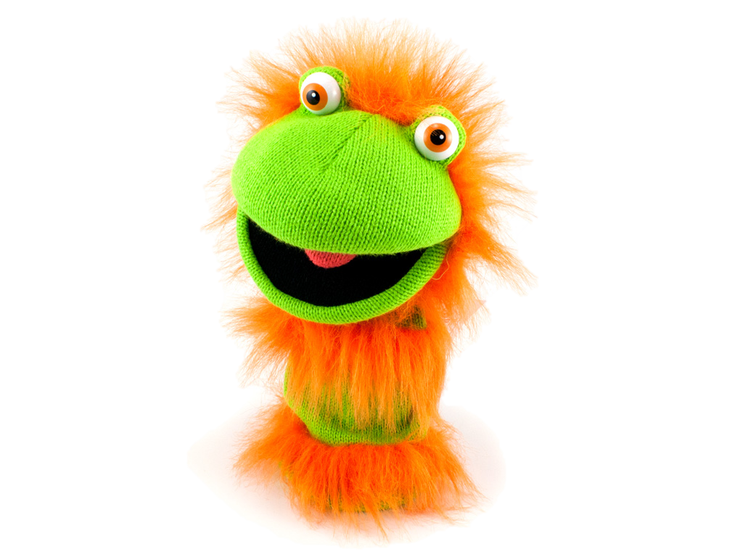
BENEFITS
Puppetry has a positive effect on students who:
are shy or lack confidence
don’t like to be seen on stage
have difficulty speaking clearly or
remembering words
learn from their peers

Slide 5
CHOROGRAPHY
Look for songs with an easy message or a simple tune.
Key words in a song can be great to give you ideas for props (i.e. Jesus, hill, lake). Make a detailed props list.
A sign can set the scene – use a picture or large letters that are readable.
Plan where the puppets are going to stand, where and when props come in and the movement of puppets particularly if moving in unison.

Slide 7
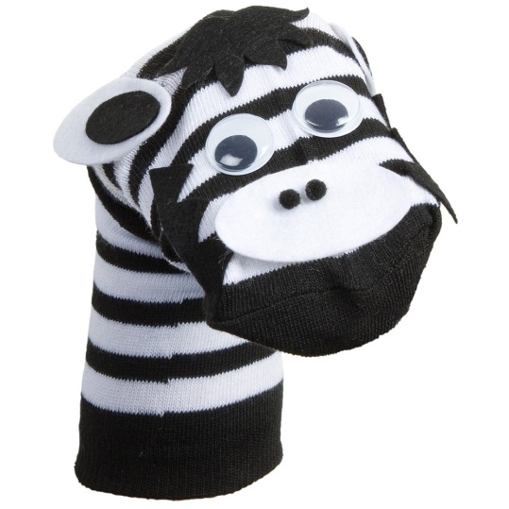
FOR THE PROFESSIONAL TOUCH
Teach the puppeteer how to come on and off stage – pretend to walk up steps, turn the puppet to the back of the stage and walk down the steps.
The puppet needs eye contact with the audience. A puppet’s eyes and where your knuckles are located on your hand. The audience always sits lower than the puppet.
The puppeteer needs to keep his/her
arm upright against their ear and move
the puppet so that it looks real and
not a stiff board.

Slide 8
FOR THE PROFESSIONAL TOUCH
It is easier for students to learn to sing a song with a C.D. than using words.
If students are using a script, pin the pages side-by-side onto the curtain or material being used as the puppet stage. Puppeteers can follow the words.
Learning to mouth words correctly takes a lot of practice.

Slide 9
PUPPETRY

